Slide 1

Unit – 4 Inheritance and Interfaces in Java

Slide 2
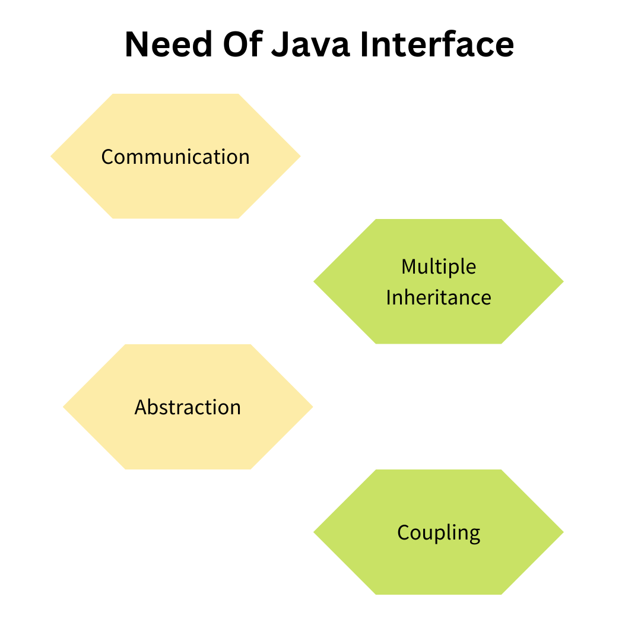
Interfaces are required in Java to achieve design flexibility, abstraction, and multiple inheritance while maintaining type safety and loose coupling.
Key Reasons for Using Interfaces
Support for Multiple Inheritance Java does not allow multiple inheritance using classes to avoid ambiguity. Interfaces allow a class to implement multiple behaviors without inheriting multiple class implementations.
Achieving 100% Abstraction Interfaces define what a class should do, not how it should do it. This separates specification from implementation.
Why Interfaces Are Needed in Java

Slide 3
Loose Coupling Between Components Code written using interface references is independent of implementation classes. This improves maintainability and scalability of large applications.
Standardization and Contract-Based Design Interfaces act as contracts that guarantee the presence of specific methods. Any class implementing the interface must follow the same method structure.
Runtime Polymorphism Support Interface references allow method calls to be resolved at runtime based on the actual object, enabling dynamic behavior.
Improved Code Reusability and Flexibility Multiple classes can implement the same interface in different ways, allowing flexible and reusable designs.
Framework and API Design Most Java frameworks (JDBC, Collections, Spring) use interfaces to hide implementation details and expose common behavior.
Why Interfaces Are Needed in Java

Slide 4
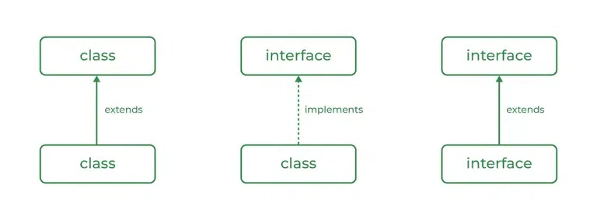
An interface in Java is a pure abstract blueprint that defines a set of method declarations which implementing classes must follow. It represents a contract that specifies what a class should do, without defining how it should do it.
Formal Definition
An interface is a reference type in Java that contains abstract method declarations and constant fields, used to achieve abstraction and multiple inheritance.
What Is an Interface in Java
Core Characteristics of an Interface
An interface contains only method declarations (no implementation logic)
All methods are implicitly public and abstract
Variables declared inside an interface are public, static, and final
An interface cannot be instantiated
Interfaces do not have constructors
A class implements an interface using the implements keyword

Slide 5
What Is an Interface in Java
Purpose of an Interface
To define common behavior that multiple classes must implement
To enforce method structure and consistency
To enable polymorphism through interface references
To separate definition from implementation
Key Conceptual Insight
An interface specifies capability, not implementation. It focuses on what actions are possible, not how they are performed.

Slide 6
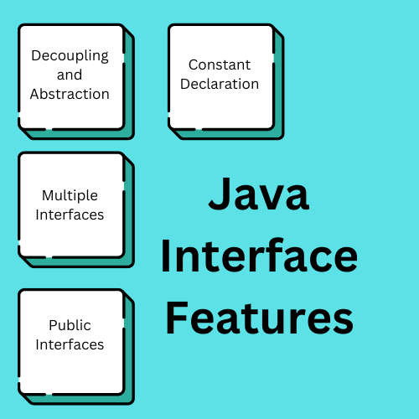
Key Properties of an Interface in Java
An interface in Java follows a strict set of rules that differentiate it from classes and abstract classes. These properties ensure complete abstraction and standardization.
Fundamental Properties
All methods are implicitly public and abstract Even if not explicitly mentioned, every method in an interface is automatically public and abstract.
All variables are implicitly public, static, and final Interface variables behave as constants and must be initialized at the time of declaration.
No method implementation (Java 7 and earlier) Interfaces only declare methods; implementation is provided by implementing classes.
Interfaces cannot be instantiated Object creation using new is not allowed because interfaces have no constructors.
Interfaces do not have constructors Since no objects can be created, constructors are not permitted.
A class can implement multiple interfaces This enables multiple inheritance of behavior in Java.

Slide 7
Design Implications
Enforces uniform method structure across unrelated classes
Promotes loose coupling between components
Enables runtime polymorphism using interface references
Key Properties of an Interface in Java
Conceptual Summary
Interfaces define rules and behavior contracts,
not object state or implementation logic.

Slide 8
Syntax of an Interface in Java
interface InterfaceName {
returnType methodName1();
returnType methodName2();
}
Important Rules
Methods do not contain implementation
Methods are implicitly public and abstract
Semicolon (;) is mandatory after method declaration
Interfaces cannot contain instance variables
Interface variables must be initialized constants

Slide 9
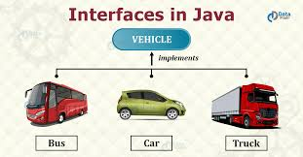
Real-World Analogy of an Interface
An interface can be understood using real-world contracts where rules are defined but implementation is left to the user.
Example: Electrical Switch
A switch defines two operations:
ON()
OFF()
The switch does not care how the device works internally
Different devices implement the switch differently:
Fan → rotates blades
Bulb → emits light
AC → controls temperature

Slide 10
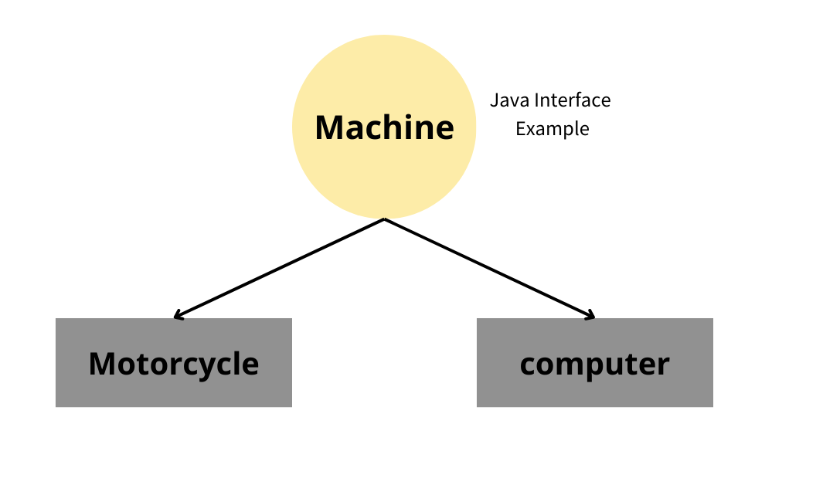
Mapping to Java Interface
Real World | Java
Switch | Interface
ON / OFF | Abstract methods
Fan / Bulb | Implementing classes
Pressing switch | Method invocation
Conceptual Understanding
Interface defines what actions are possible
Implementation class defines how actions are performed
Same interface can have multiple implementations
Why This Is Important in Java
Promotes loose coupling
Supports polymorphism
Makes programs flexible and scalable

Slide 11
Interface Vehicle { void start(); void stop(); }
Creating an Interface in Java
Important Observations
No method body is provided
No object can be created from the interface
Interface only specifies what actions are required
Implementation is responsibility of the class
Design Perspective
Interface acts as a behavior specification
Multiple classes can implement the same interface
Ensures uniform method structure across implementations

Slide 12
Implementing an Interface in Java
class Car implements Vehicle {
public void start() {
System.out.println("Car started");
}
public void stop() {
System.out.println("Car stopped");
}
}
Important Rules While Implementing an Interface
All interface methods must be implemented
Implemented methods must be public
Method signature must exactly match the interface declaration
A class can implement multiple interfaces

Slide 13
Rules and Restrictions While Implementing an Interface
Mandatory Rules
All abstract methods must be implemented A class must provide implementations for every method declared in the
interface.
Implemented methods must be public Reducing access level is not allowed because interface methods are implicitly
public.
Method signature must match exactly Method name, return type, and parameters must be the same as declared in
the interface.
A class can implement multiple interfaces This allows Java to support multiple inheritance of behavior.
Restrictions
A class cannot partially implement an interface If any method is not implemented, the class must be declared abstract.
Interface methods cannot be overridden with weaker access modifiers
Interface variables cannot be modified (they are constants)
Special Case
An abstract class may implement an interface without implementing all methods

Slide 14
Using an Interface Implementation in a Program
class TestVehicle {
public static void main(String[] args) {
Car c = new Car();
c.start();
c.stop();
}
}
Important Observation
Object creation is done using the class name, not the interface
Interface methods are executed using the class implementation
Design Insight
Interface defines behavior
Class provides implementation
Object executes behavior

Slide 15
Interface Reference in Java
Java allows the creation of a reference variable of interface type that can refer to
an object of any class that implements that interface.
Concept Explanation
An interface cannot create objects
An interface can create references
The reference can point to any implementing class object
This enables runtime polymorphism.
Syntax of Interface Reference:
InterfaceName ref = new ImplementingClass();
Key Observations
Reference type decides which methods are accessible
Object type decides which implementation is executed
Method binding happens at runtime
Why Interface Reference Is Important
Promotes loose coupling
Supports dynamic behavior
Allows code to depend on abstraction, not implementation

Slide 16
Interface Reference – Example
interface Shape {
void draw();
}
class Circle implements Shape {
public void draw() {
System.out.println("Drawing Circle");
}
}
Using Interface Reference
class Demo {
public static void main(String[] args) {
Shape s = new Circle();
s.draw();
}
}
Key Observation
Even though the reference is of type Shape, the draw() method of Circle is executed.

Slide 17
Runtime Polymorphism Using Interface
Runtime polymorphism occurs when a method call is resolved at runtime based
on the actual object, not the reference type.
How Runtime Polymorphism Works
Interface reference holds the address of the object
JVM determines the actual object type at runtime
Corresponding method implementation is executed
Shape s = new Circle();
s.draw();
Important Observations
Method call is not decided at compile time
Decision is made during execution
This is also called Dynamic Method Binding
Why Runtime Polymorphism Is Important
Enables flexible and extensible code
Supports plug-and-play implementations
Reduces dependency on concrete classes
Runtime polymorphism allows one interface reference to represent multiple object behaviors dynamically.

Slide 18
Why JVM Executes Object’s Method (Internal View)
When an interface reference is used to call a method, the Java Virtual Machine (JVM)
determines which method to execute at runtime based on the actual object stored in memory.
Memory-Level Understanding
Interface reference stores the address of the object
The object is created in heap memory
The object contains a method table (runtime binding information)
JVM uses this information to locate the correct method
Shape s = new Circle();
s.draw();
Key Points
Method binding happens during execution
Compile-time checking ensures method existence
Runtime decides which implementation to execute
Relation to Dynamic Method Dispatch
This process is called Dynamic Method Dispatch
Enables runtime decision-making
Foundation of polymorphism in Java

Slide 19
The instanceof operator is used to check the actual type of an object at runtime. It helps determine whether an object belongs to a specific class or implements a
particular interface.
instanceof
Operator in Java
Definition
The instanceof operator tests whether an object is an instance of a given class or interface
and returns a boolean value.
objectReference instanceof ClassOrInterfaceName
Key Characteristics
Evaluated at runtime
Returns true or false
Works with classes and interfaces
Prevents invalid type casting
Why instanceof Is Required
When reference type is parent/interface
Actual object type is unknown
Safe type checking before casting
Used in polymorphic behavior
instanceof checks the real identity of the object, not the reference type.

Slide 20
Using instanceof with Interface – Example
interface Animal {
void sound();
}
class Dog implements Animal {
public void sound() {
System.out.println("Dog barks");
}
}
class TestInstanceOf {
public static void main(String[] args) {
Animal a = new Dog();
if (a instanceof Dog) {
System.out.println("Object is of type Dog");
}

Slide 21
Using instanceof with Interface – Example
if (a instanceof Animal) {
System.out.println("Object implements Animal interface");
}
a.sound();
}
}
Important Observation
instanceof works with:
Concrete classes
Parent classes
Interfaces
The instanceof operator validates the object’s actual type in memory, ensuring safe runtime behavior.

Slide 22
Why instanceof Is Important in Polymorphism
In polymorphic behavior, a reference variable of a parent type or interface may refer to objects of different classes.
The instanceof operator helps identify the actual object type during runtime.
Problem in Polymorphism
When using:
Animal a = new Dog();
Reference type: Animal
Actual object type: Dog
Compile-time type: Animal
Runtime type: Dog
The reference does not reveal the exact object type.

Slide 23
Role of instanceof
Determines the real object type
Enables safe downcasting
Prevents runtime errors
Allows conditional behavior based on object type
Why instanceof Is Important in Polymorphism
if (a instanceof Dog) {
Dog d = (Dog) a;
d.sound();
}
Why It Matters
Without instanceof:
Incorrect casting may cause ClassCastException
Program may fail at runtime
instanceof acts as a runtime type verification mechanism in polymorphic scenarios.

Slide 24
ClassCastException and the Role of instanceof
In Java, incorrect type casting during runtime can lead to a ClassCastException.
This typically occurs in polymorphic situations when an object is cast to an incompatible type.
What Is ClassCastException?
ClassCastException is a runtime exception thrown when an object is cast to a class of which it is not an instance.
Example of Incorrect Casting
Animal a = new Dog();
Cat c = (Cat) a; // Runtime Error
Reference type: Animal
Actual object type: Dog
Casting to Cat is invalid
JVM throws ClassCastException

Slide 25
How instanceof Prevents This Error
if (a instanceof Cat) {
Cat c = (Cat) a;
}
Checks object type before casting
Prevents unsafe casting
Ensures runtime safety
Why This Is Important
Polymorphic references hide actual object type
Safe casting is essential in large applications
Reduces unexpected runtime failures
instanceof ensures that type conversion is valid before performing explicit casting.

Slide 26
Understanding System.out.println() – Internal Structure
The statement System.out.println() appears simple, but it is actually a chain of class, object, and method references working together.
System.out.println("Hello Java");
Component | Type | Description
System | Class | Predefined class in java.lang package
out | Static Object | Public static instance of PrintStream
println() | Method | Method of PrintStream class
Detailed Explanation
System
A final class provided by Java
Contains useful static members
out
A static variable inside System
Declared as:

Slide 27
Understanding System.out.println() – Internal Structure
public static final PrintStream out;
Represents the standard output stream
println()
A method of PrintStream
Prints data and moves the cursor to the next line
Execution Flow
JVM loads System class
Accesses static object out
Calls println() method of PrintStream
Data is printed to console
System.out.println() is a method call on a static object defined inside a predefined class.

Slide 28
Definition
Interface inheritance is the mechanism in Java where one interface extends another interface using the extends keyword and inherits its abstract method declarations.
Conceptual Understanding
Interfaces can form hierarchical structures.
A child interface automatically acquires all abstract methods of the parent interface.
This promotes structured abstraction.
Key Characteristics
Uses the extends keyword
Only interfaces can extend interfaces
Multiple inheritance is supported
No implementation is inherited (only method declarations)
Why Interface Inheritance is Required
To organize related behaviors logically
To build modular abstraction layers
To extend capability without modifying existing interfaces
To support scalable architecture
Interface Inheritance in Java

Slide 29
Real-Life Analogy
Consider:
Basic Device → defines basic operations
Smart Device → extends Basic Device
A Smart Device automatically has all capabilities of a Basic Device, plus additional smart features.
Academic Insight
When Interface B extends Interface A:
B contains all methods of A
Any class implementing B must implement methods of both A and B
Important Rule
If an interface extends multiple interfaces, it inherits all abstract methods from each interface.
Interface Inheritance in Java

Slide 30
Definition
Multiple Interface Inheritance in Java allows one interface to extend more than one interface, thereby inheriting abstract methods from multiple sources.
Conceptual Explanation
Unlike classes, Java allows interfaces to inherit from multiple interfaces.
This enables multiple inheritance of behavior without ambiguity because interfaces do not contain method implementations.
Why Java Allows Multiple Inheritance in Interfaces
Interfaces contain only abstract method declarations
There is no implementation conflict
Therefore, ambiguity problem does not arise
Key Characteristics
Uses extends keyword
Supports inheritance from multiple interfaces
Child interface inherits all abstract methods
Promotes modular design
Multiple Interface Inheritance

Slide 31
Conceptual Structure
If:
Interface C extends Interface A and Interface B
Then:
C contains all abstract methods of A and B
Any class implementing C must implement all methods from A, B, and C.
Real-Life Analogy
Consider:
Interface Printer → print()
Interface Scanner → scan()
Interface Copier extends Printer, Scanner
A Copier device must be able to print and scan.
This models real-world capability composition.
Academic Insight
Multiple interface inheritance:
Encourages capability-based design
Avoids diamond problem
Supports flexible architecture
If an interface extends multiple interfaces, any implementing class must provide implementations for all inherited abstract methods.
Multiple Interface Inheritance

Slide 32
Implementing Inherited Interfaces
Definition
When a class implements an interface that extends one or more interfaces, the class must provide implementations for all abstract methods declared in the entire interface hierarchy.
Conceptual Explanation
If:
Interface C extends A and B
Then:
Any class implementing C must implement:
All methods of A
All methods of B
All methods of C
This ensures complete fulfillment of the abstract contract.
Why This Rule Exists
Interfaces define behavior contracts
Implementation must be complete
Partial implementation violates abstraction

Slide 33
Hierarchical Understanding
Interface A → declares method1()
Interface B → declares method2()
Interface C extends A, B → declares method3()
A class implementing C must define:
method1()
method2()
method3()
Important Academic Observation
Even if methods are not directly declared in the child interface, they are inherited and must be implemented.
Real-Life Analogy
Consider:
BasicDevice → powerOn()
NetworkDevice → connectToNetwork()
SmartDevice extends both
If a company manufactures a SmartDevice, it must support:
powerOn
connectToNetwork
any additional smart features
Failure to implement any capability means the device is incomplete.
Implementing Inherited Interfaces
Key Rules
A class cannot skip inherited interface methods
If not fully implemented, the class must be declared abstract
Interface hierarchy does not reduce implementation responsibility

Slide 34
Definition
Dynamic Method Dispatch is the mechanism by which a call to an overridden method is resolved at runtime rather than at compile time.
Concept
In Java, when a superclass or interface reference refers to a subclass object, the method that gets executed is determined by the actual object type during runtime.
This is the foundation of runtime polymorphism.
Why It Is Called “Dynamic”
Method binding happens during execution
JVM determines the correct method implementation
Decision is not made at compile time
Core Principle
Reference Type → Decides accessible methods
Object Type → Decides executed method
Dynamic Method Dispatch

Slide 35
Execution Flow Concept
Reference variable created
Object created using subclass
Method is overridden
JVM checks actual object type
Corresponding method executes
Real-Life Analogy
Consider:
A remote control (reference)
Connected to a TV (object)
If remote is connected to TV → TV functions
If connected to AC → AC functions
Same reference, different behavior depending on object.
Important Conditions
Method must be overridden
Inheritance must exist
Reference should be parent type
Object should be child type
Dynamic Method Dispatch
Dynamic Method Dispatch enables:
Runtime polymorphism
Flexible architecture
Extensible system design

Slide 36
Internal Working of Dynamic Method Dispatch
Concept Overview
Dynamic Method Dispatch works through runtime method binding, where the Java Virtual Machine (JVM) determines which overridden method to execute based on the actual object stored in memory.
Compile-Time vs Runtime Behavior
At Compile Time:
Reference type is checked
Method existence is verified
Access control is validated
At Runtime:
JVM checks the actual object type
Overridden method is selected
Correct method implementation executes
Memory-Level Understanding
When:
Parent obj = new Child();
obj is a reference variable stored in stack memory
Child object is created in heap memory
The reference points to the child object
During method call:
obj.display();
JVM inspects the actual object in heap and executes the overridden method in Child.

Slide 37
Why Parent Method Does Not Execute
Even though the reference type is Parent:
The method is overridden
JVM prioritizes the object type
Therefore, child method is executed
Key Technical Insight
Dynamic method dispatch uses virtual method table (VMT) internally to determine the correct method implementation.
Conditions Required
Inheritance must exist
Method must be overridden
Reference type must be parent class or interface
Object must be subclass implementation
Real-Life Analogy
Think of:
A manager (reference)
Working with different employees (objects)
Depending on the actual employee assigned, behavior differs even though manager reference is same.
Internal Working of Dynamic Method Dispatch

Slide 38
Definition
An abstract class in Java is a class declared using the abstract keyword that cannot be instantiated and may contain both abstract and concrete methods.
Conceptual Understanding
An abstract class is used when:
We want to provide partial implementation
Some methods must be implemented by subclasses
Some common functionality should be shared
It represents an incomplete blueprint.
Key Characteristics
Declared using abstract keyword
Cannot create objects directly
May contain:
Abstract methods (without body)
Concrete methods (with body)
Constructors
Instance variables
Static methods
Why Abstract Class Is Needed
To provide common base functionality
To enforce method implementation in subclasses
To achieve partial abstraction
To reduce code duplication
Abstract Class in Java

Slide 39
Abstract Class in Java
Important Rule
If a class contains even one abstract method, the class must be declared abstract.
Real-Life Analogy
Consider:
A class called Shape.
All shapes have area(), but each shape calculates area differently.
Shape defines:
calculateArea()
But actual implementation is done in:
Circle
Rectangle
Triangle
Shape is abstract because we cannot define area formula universally.
When to Use Abstract Class
When classes share common code
When hierarchy is clearly defined
When you want to provide default implementation
Insight
Abstract class is a mechanism to achieve partial abstraction, unlike interface which traditionally supports complete abstraction.

Slide 40
Understanding Abstract Class (Features in Depth)
An abstract class is used when we want to create a base class that gives common functionality but still forces subclasses to implement some specific behavior.
It is neither completely implemented nor completely undefined — it is partially defined.
What Makes an Abstract Class Different?
We cannot create its object directly.
It may contain abstract methods (methods without body).
It may also contain normal methods with full implementation.
It can have instance variables.
It can have constructors.
It supports inheritance, but only single inheritance
Why Do We Need It?
Sometimes we know that all subclasses must follow certain rules, but the exact implementation will differ.
For example:
All shapes have an area.
But how area is calculated depends on the shape.
So instead of writing separate unrelated classes, we create a common abstract class.

Slide 41
Understanding Abstract Class (Features in Depth)
Important Rule
If even one method is declared abstract, the entire class must be declared abstract.
Design Perspective
An abstract class is useful when:
You want to share common code among related classes.
You want to enforce certain methods in subclasses.
You want partial abstraction, not complete abstraction.
Think About This
Can we create:
Shape s = new Shape(); ?
No. Because Shape is incomplete.
But we can create:
Circle c = new Circle();

Slide 42
Basic Idea
An abstract class is used when classes are closely related and share common code.
An interface is used when classes may be unrelated but must follow a common behavior contract.
Key Differences
1. Methods
Abstract class can have both abstract and concrete methods.
Interface traditionally contains only abstract methods (used for full abstraction).
2. Variables
Abstract class can have instance variables.
Interface variables are always constants (public, static, final).
3. Constructors
Abstract class can have constructors.
Interface cannot have constructors.
4. Inheritance
A class can extend only one abstract class.
A class can implement multiple interfaces.
5. Purpose
Abstract class → used for code reuse and partial implementation.
Interface → used to define behavior contracts.
Abstract Class vs Interface
When should we use an abstract class?
When should we use an interface?

Slide 43
Now the real question is not the difference.
The real question is:
When should we use which?
Because in real projects, both are available.
Use Abstract Class When:
Classes are closely related.
You want to share common code.
You need instance variables.
You need constructors.
You want partial abstraction.
Example:
All vehicles share engine logic → better use abstract class.
Use Interface When:
You only want to define behavior.
Classes may be unrelated.
Multiple inheritance is required.
You want loose coupling.
You want flexible system design.
Example:
Payment method → UPI, Card, NetBanking
They are unrelated classes but follow same contract → use interface.
Choosing Between Abstract Class and Interface

Slide 44
Choosing Between Abstract Class and Interface
Practical Design Thinking
If you ask yourself:
“Do I need common code?”
→ Use abstract class.
“Do I only need a rule that everyone must follow?”
→ Use interface.
Modern Java Note
In modern Java versions, interfaces can have default methods.
But still:
Abstract class → state + behavior
Interface → behavior contract
Final Integration Understanding
Abstract Class = Partial abstraction + shared implementation
Interface = Complete abstraction + multiple inheritance
Both are tools for abstraction.
The difference lies in design intention.

Slide 45
Thank you

